Slide 1

ML 101 Course
Arush Garg
AI and Machine Learning Club
Overseas Family School

Slide 2

Course (bit.ly/ML_101)
Introduction to Machine Learning (ML)
Regression
Core ML concepts
Classification
Decision Trees
Model selection and tuning
Unstructured data: Text
Neural Networks
Unstructured data: Images
Introduction to Deep Learning
Beyond Regression & Classification
Notes:
Welcome back to the ML 101 course. Today we will go deeper into Regression, more specially Linear Regression.

Slide 3
Recap
ML is the science of getting computers to learn without being explicitly programmed
Types of Machine Learning algorithms
Supervised learning
Unsupervised learning
Reinforcement learning
Supervised learning
train a computer by feeding in data with right answers, so it can learn to give correct answers for new inputs it hasn't seen before
E.g. predict whether the picture is of a dog or cat (classification), predict the price of a house (regression)
Introduction to ML model lifecycle
(1) Data exploration, (2) Data preparation & feature engineering, (3) Model selection & training, (4) Model evaluation & tuning, (5) Model deployment. It is an iterative process
Covered a hands-on exercise to train a Linear Regression model
Notes:
Quick recap of what we have covered so far. We discussed how machine learning differs from traditional programming as in machine learning we expect computers to learn without being explicitly programmed.
We also got introduced to “Supervised learning” - where the training data contains both input features and the labels to predict.
Finally we did a hands on exercise to train a linear regression model. That helped us get a feel for difference stages of an ML model’s lifecycle.

Slide 4
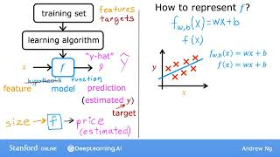
Linear Regression:
f(x) = wx + b = mx + c = equation of a line
Machine Learning Specialization Course by DeepLearningAI [link]
Notes:
We have already used the term linear regression multiple times, let’s learn what exactly it refers to now. Keep in mind that F(x) = wx + b is the same as the formula for a line, y = mx + c.
(play video)

Slide 5
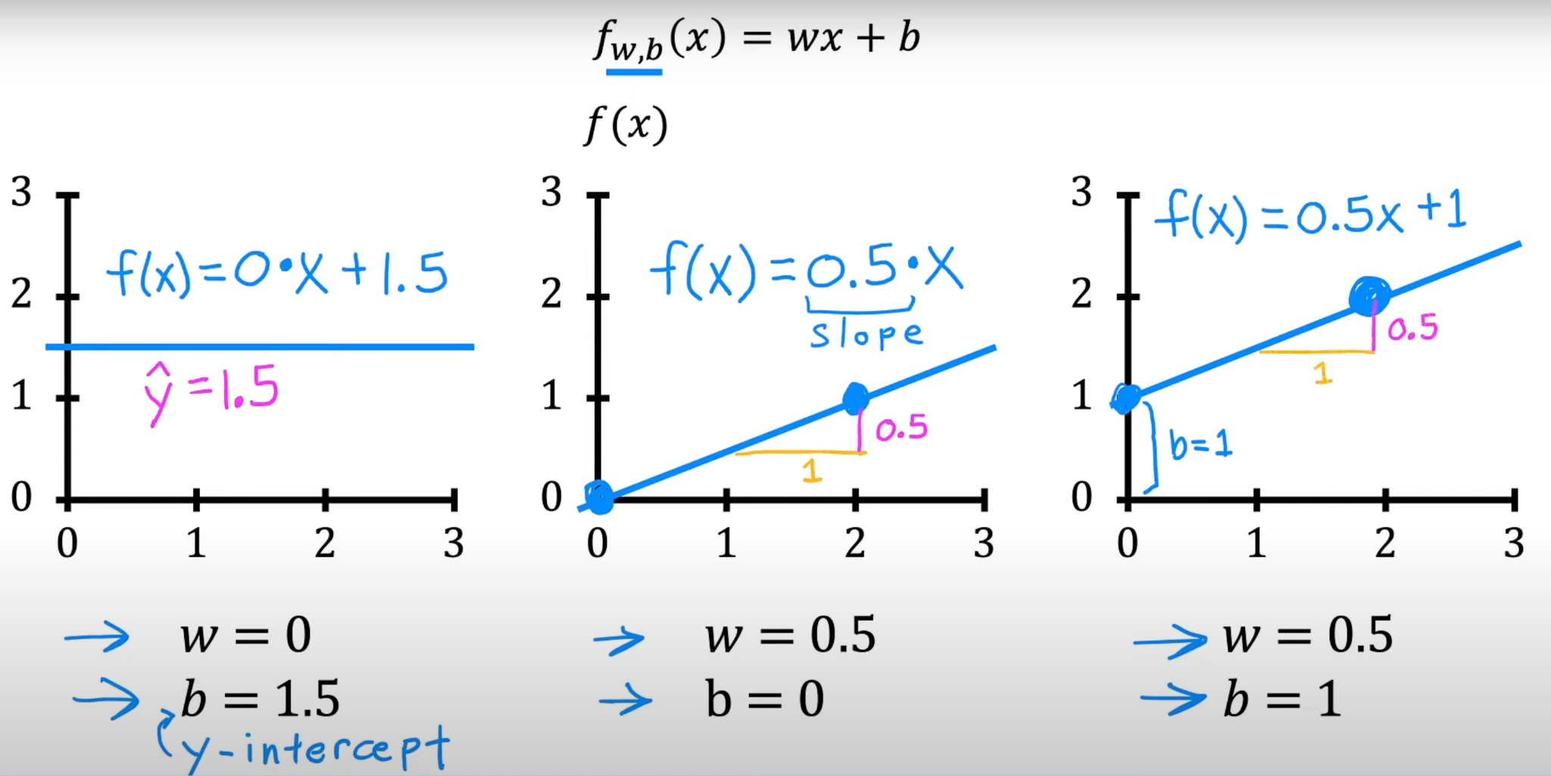
Training Linear Regression model = Figuring out ‘w’ & ‘b’
‘w’ & ‘b’ are also called “model parameters or weights”
Goal of “training a linear regression model” is to:
figure out the values of ‘w’ and ‘b’
such that it is able to
make predictions using “wx + b” equation
with
high accuracy for all values of x.
Machine Learning Specialization Course by DeepLearningAI [link]
ML is not magic, it is mathematics :-)
Notes:
“W” & “b” are also called model parameters or weights. Given that “x” is an input variable, all we need to do to learn a Linear Regression model is to figure out the values of “w” and “b”. Not any value will work, we need to figure out these values such that we are able to make predictions with high accuracy.
Sometimes ML might feel like magic, but in reality it is mathematics.

Slide 6
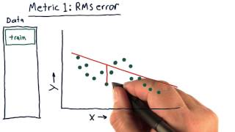
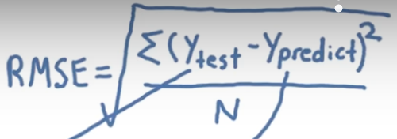
How to evaluate the quality of a Linear Regression model?
∑ = sum
In this case we are adding “prediction error” for all data points in the set
N = number of data points in the set
(Y_{test} - Y_{predict}) can be -ve.
That’s why we do “square”. It also helps amplify big mistakes.
Machine Learning Specialization Course by DeepLearningAI [link]
Notes:
Earlier we mentioned that we want to find model parameters such that it has high accuracy? But how do we measure the quality of a Linear Regression model. The most commonly used metric is called root mean square error.
(play video)
(click next)
This symbol represents summation. Here we are adding the square of all errors. And we square the errors because some errors can be -ve.

Slide 7
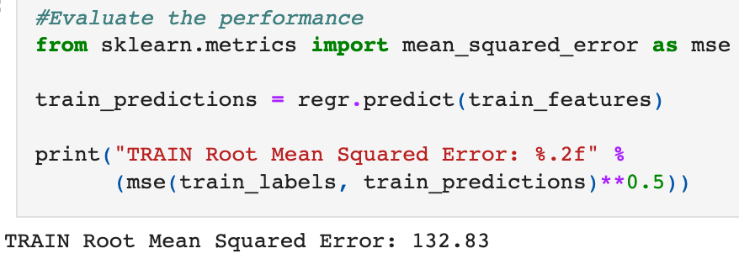
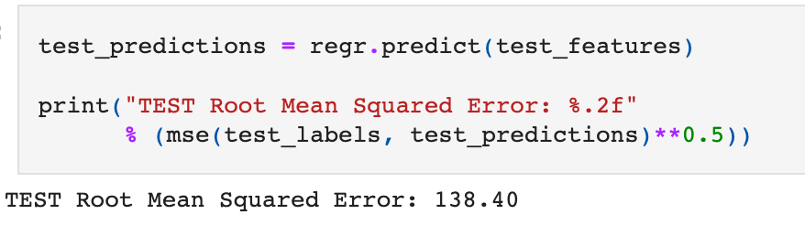
Training error vs Test error
RMSE for Training Data
RMSE for Test Data
This is what matters!
bit.ly/ML_101//01%20Introduction/FirstModel.ipynb
Notes:
In the last week exercise we calculated RMSE twice. First for the training data. That tells how well the model performs on the data it was trained on.
But our goal is do well on unseen data. That’s why a more reliable metric to measure model quality would be the RMSE on test data because test data was not part of the model training.

Slide 8
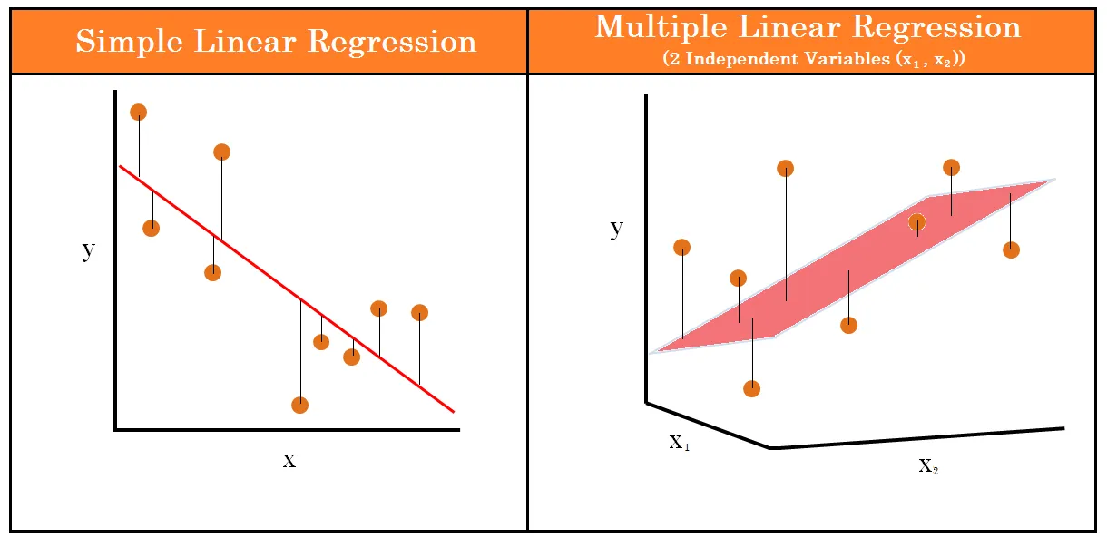
Multivariate Linear Regression = Multiple Input features (x)
1 input feature x₁, Linear Regression model is a “line”
2 input features x₁ and x₂, Linear Regression model is a 3-D hyperplane
‘n’ input features, Linear Regression model is a “n+1” dimension hyperplane (can’t visualize)
y = b + w₁x₁ + w₂x₂ + w₃x₃ + … +w_{n}x_{n}
As part of model training we learn “b” and “w₁, w₂, … w_{n}”
Source: Antony Christopher, Medium
y = w₀x₀ + w₁x₁ + w₂x₂ + w₃x₃ + … w_{n}x_{n}
such that b = w₀ and x₀ = 1
In short, y = ∑w_{i}x_{i}
Notes:
In our exercise we predicted SAT Score based on a single input feature, GPA. But for most real world problems, single input feature is not enough to train a good quality model. Linear Regression equation can be extended to include multiple input features. In case of 2 input features, Linear Regression model represents a 3D hyperplane.
For every input feature x_{i}, there is a corresponding weight parameter w_{i} that is learnt as part of model training.
(click) And this is another way to write the same equation in a way that is more concise

Slide 9
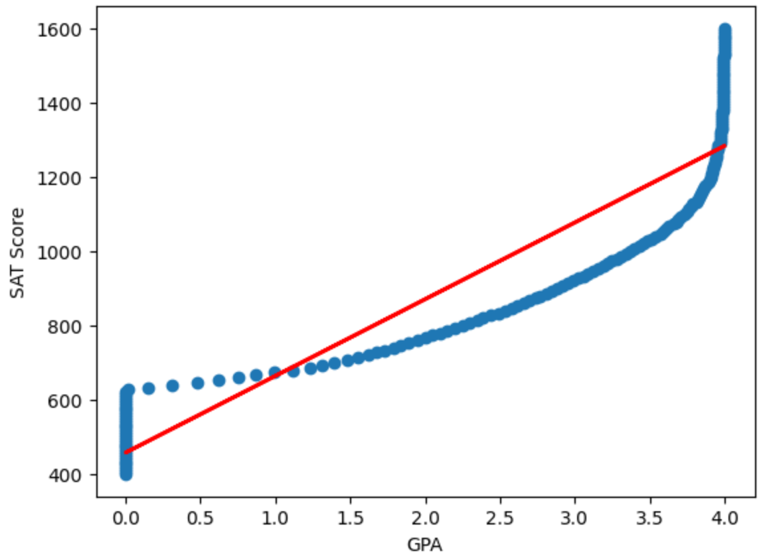
Using Linear Regression to capture non-linear correlations
Correlation between GPA and SAT Score is non-linear.
Does that mean we cannot use Linear Regression here?
Not really, Feature Engineering to the rescue.
We can create new input features like x², x³, log(x), …
Each of these new features can be used as an additional input feature in the Linear Regression model. E.g.
y = b + w₁x₁ + w₂x₁² + w₃x₁³
We will get to practice this in today’s hands-on exercise
Notes:
From this scatter-plot it is clear that the correlation between GPA and SAT Score is non-linear. Hence fitting a straight line is not going to help.

Slide 10
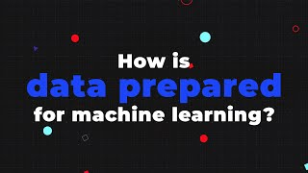
Data reduction & cleansing: Garbage in, Garbage out
Dimensionality Reduction
Sampling
remove bias
speed up prototyping
Data Cleaning
Handle missing Values
Remove Outliers
Impute bad data
Source: AltexSoft
Notes:
Another important topic is data reduction & cleansing. Remember, our ML model will be only as good as the quality of data it will learn from.
In our hands-on exercise we worked with very small and clean data but that is uncommon in real-world data. Let’s understand some of the common data reduction & cleaning steps involved in preparing data for machine learning.

Slide 11
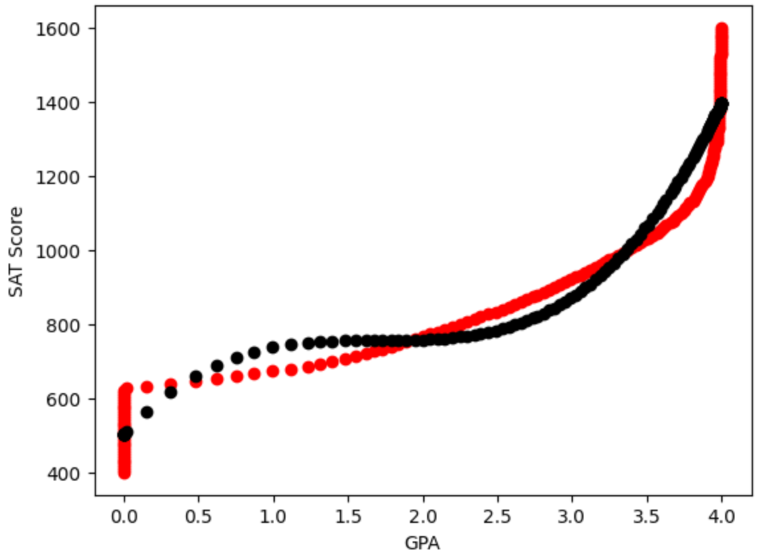
Hands-on Exercise (bit.ly/ML_101)
Multivariate Linear Regression
Python Notebook: …/02 Regression/GPA_SAT.ipynb
Notes:
In the hands-on exercise, we will continue working on the SAT prediction model. This time, we will include two new features, GPA squared and GPA cubed.
The final performance of the model is shown in the graph, and it is much better than the model we trained last lesson.

Slide 12

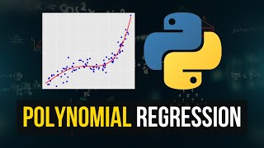
Further Reading / Watching / Doing
Practice notebook
Refer to …/02 Regression/problem.md
For instructions regarding another Linear Regression practice problem. You can also learn & practice “data cleaning” in this one.
Source: AltexSoft
https://www.analyticsvidhya.com/blog/2021/06/how-to-clean-data-in-python-for-machine-learning/
https://towardsdatascience.com/how-to-clean-your-data-in-python-8f178638b98d
Source: NeuralNine
Notes:
To try another problem and get some experience with data cleaning, look at the problem.md file in the repo. I have included a data cleaning notebook and my approach to the problem.

Slide 13
Agenda for next class
Core ML concepts
Understand how ML algorithms figure out (learn) the model parameters / weights (w, b)
Cost function
Gradient descent algorithm
Underfitting / Overfitting
Feature Engineering
Handling categorical values
Notes:
In the next lesson, we will understand how Linear Regression model figures out the best parameters as part of model training.
In addition, we will learn about the risks of underfitting and overfitting, along with tips to avoid this. Finally, we will learn about handling categorical values using a technique called One-Hot Encoding.

Slide 14
Linear Regression Output without Feature Engineering
Linear Regression Output with Feature Engineering

